Slide 1
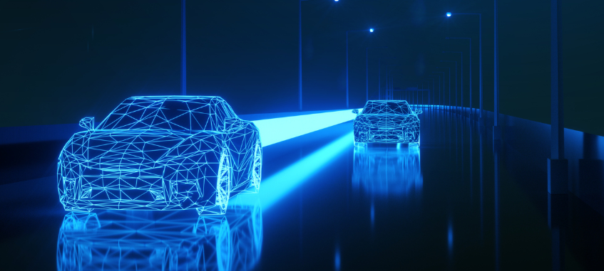
Machine Learning supported Multiagent Resource Allocation in Autonomous Vehicle Fleets.
By Mohamad Kassem
Supervisors: Prof. Flavien Balbo & Alaa Daoud
Context: Master1 CPS2 Internship
Supervisors: Prof. Pierre Maret & Prof. Olivier Boissier
1st September 2021

Slide 2
Outline:
Problem Description
Internship Objective and Hypothesis
The Plan to achieve this Objective
State of the art
MAS Coordination in ODT
Machine Learning Model
Conclusion
References

Slide 3
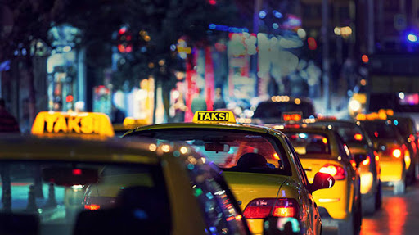
Problem Description
DARP:
Plan routes for n users, using a set of m vehicles, with the minimum possible cost.
ODT:
Driving passengers from their origin to their destination.
Resource Allocation Mechanisms:
Because it is NP-Hard Complexity to solve DARP. Researches instead tends to focus on allocation mechanisms as an ODT solutions to solve the problem. These mechanisms are different algorithms and approaches such as, the greedy approach where the vehicles in the systems are modeled as greedy agents in a decentralized multi-agent system. Where each agent aim’s to find his own best route without thinking about the other agents.

Slide 4
Internship Objective and Hypothesis
Objective:
We aim to minimize the cost of taxi trips through building and integrating a machine learning model into the agent's reasoning behavior. Then compare the agent’s decision and its effect on our decentralized multi-agent system, before and after the insertion of the model, using different allocation mechanisms, including Auctions and Greedy Approaches.
Hypothesis:
“Can we minimize the cost of taxi trips through building and integrating a machine learning model into the agent's reasoning behavior?”
Model Hypothesis:
"Given a number of passengers n in a certain zone z during a time slot t, can we
predict the number of passengers n' in the same zone z at next time slot t+1 ?"

Slide 5
The Plan to achieve this objective
For this topic, the internship working time was divided into 2 main stages:
Stage1:
Working Environment: This includes understanding the DARP problem and the original project, ORNInA and other approaches, the part of the java code we are interested in on the simulation…
Dataset: Preparing and Analyzing the dataset, NYC-TLC Dataset (New York City - Taxi and Limousine Commission) which contains taxi trip records in New York city between the years of 2009 and 2021 (And in our case 2018).
State of the Art: Reading existing papers and approaches in the domain.
Stage2:
Running and understanding Greedy Approach and Auction code original instances (before the model).
Building, training and testing the targeted Machine Learning Model, to achieve a 89% accuracy.
Add the model into the agent’s belief and create new cost equation that takes the model into consideration, before running the simulation again (with the model this time) and compare results.

Slide 6
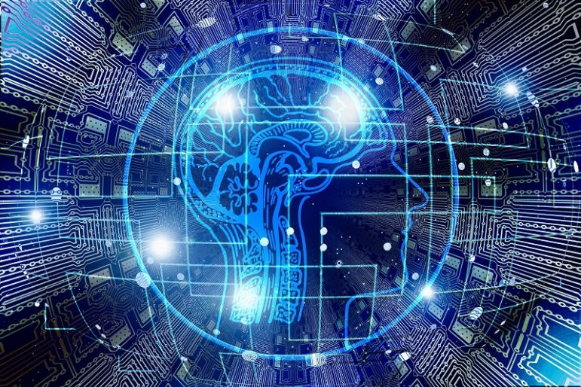
State Of The Art

Slide 7
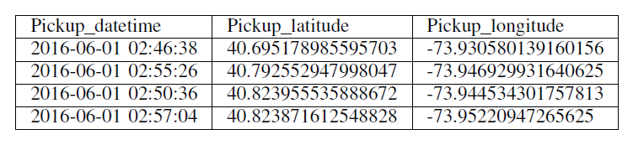
1- A Sequence Learning Model With Recurrent Neural Networks For Taxi Demand Prediction
This paper focuses on the application of RNN for learning a model that predicts taxi demand based on the requests in the past. A model that can learn time series data is necessary here since taxi requests in the future are related to the requests in the past. And to let the model learn time series data the authors used LSTM Layers.
Data Preparation:
They are using GPS records from NYC Taxi trip dataset
(this dataset consists of 3.5 years taxi trips in the city).
These GPS Data needs to be encoded first. And after encoding, the entire city was divided into small areas. Where each area has its taxi trip information calculated from the trips inside it.

Slide 8
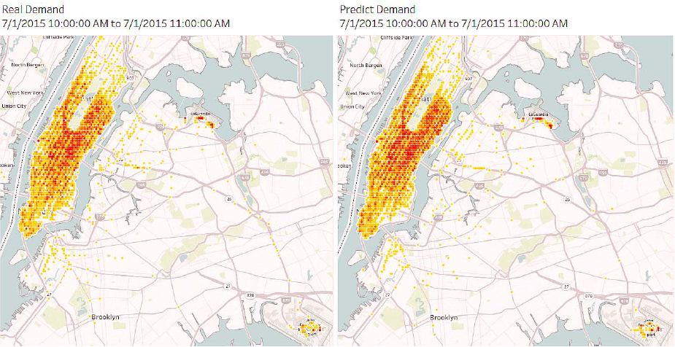
Final Result
Experimental results show that the achieved predictor model was capable to continuously make real-time prediction of taxi demand for the entire city with a high level of accuracy. (Figure)
The accuracy of the model was compared to the Naive model prediction, which showed a huge success of the built model.

Slide 9
2- Forecasting Taxi Demands With Fully Convolutional Networks And Temporal Guided Embedding
In this work, the authors focus on building a taxi demand prediction model based on:
Complex spatiotemporal patterns (Space – Time Patterns)
Temporal guided networks (TGNet).
Traffic data analysis using NYC-Taxi Dataset.
Dataset:
From NYC-Taxi Dataset they have taken taxi trip records in 2015 from 01/01 to 01/03 (60 days).
The records of first 40 days are taken as Training Data.
The records of last 20 days are taken as Testing Data.
Results:
The built model was compared to other models that were used before to predict similar information. Models such as CNN with LSTM , ConvLSTM and several other models. And the numbers were able to prove that this model in most of the cases works better than the other models in terms of more accurate predictions.

Slide 10
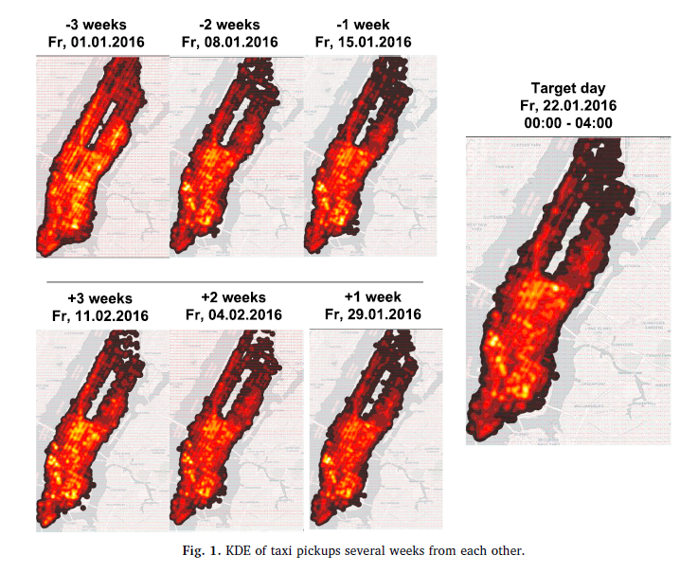
3- Predicting Taxi Demand Hotspots Using Automated Internet Search Queries
In order to predict taxi demands, in this work the authors focus on predicting Hotspots (Crowded locations) in New York City using:
Internet Search Queries
Big Databases of information
Data extraction from NYC dataset
The authors claims that if we target a specific place and time during the week to observe taxi trip demands. And then we compare this amount of demands with the same space-time demands in the other weeks, we can observe similar patterns as shown in the figure. These patterns can help us define the hotspots in the city. (fig)

Slide 11
MAS Coordination In ODT

Slide 12
Auctions
When talking about Auctions, there are 2 different types:
Ascending-Bid auction: In an ascending auction, price and allocation are determined in an open competition among the bidders. The bidders willing to pay the most win and pay prices that no other bidders are willing to top.
First-Price Auction: several advertisers bid a set amount of money per impression, and the highest bidder wins and pays the amount that they've bid.
In our Auction model we use "First-Price Auction" to answer the question "Which vehicle will consume the request and at what cost"

Slide 13
Auctions-Based System
Clients request for demands di of the form:
d = <seats_required , tw , pick_up , drop_off>
Each vehicle agent offers a certain Bid for this demand stating:
The demand number
The vehicle name (His name)
The starting time
The cost
And at the end, one of the Bidders will win the auction though a certain winning determination criteria.

Slide 14
Winner Determination
Considering all vehicles as truthful collaborating agents, each vehicle determines its own value of winning an auction though win(v,d) where the default value is zero.
The bid is available until t<expire>. Until this time if a vehicle received a better offer it assigns itself as a looser in this auction (sets win(v,d) to 0).
At t<expire> if the cost of v is less than any other cost thus it will has a value win(v,d) = 1. It considers itself a winner at this Auction and adds the demand d to the queue of demands.

Slide 15
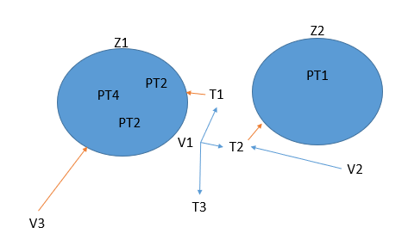
Agent’s Behavior

Slide 16
ML Prediction Model

Slide 17
Outline:
Model Definition
Dataset
Environment
Data Preparation
Model Architecture
Model Training
Resources limitation
Results

Slide 18
Model Definition
This model will predict future information that can help the agents in the system to behave in
more a intelligent way, in order to reach their goals.
The model can be defined as:
Time Slots: {t1, … , ts} (s is the number of time slots, which depends on a variable time slot size).
Zones: {z1, … ,zn} (n = number of zones in the dataset = 265).
Number of requests: {nij} of each zone at each time slot.
Input:
We formulate our dataset in the form X = [{ti , zj , nij}]. For every i,j in the domain.
Output:
Yj = {n(i+1)j}
Model Hypothesis: (Recap)
"Given a number of passengers n in a certain zone z during a time slot t, can we
predict the number of passengers n' in the same zone z at next time slot t+1 ?"

Slide 19
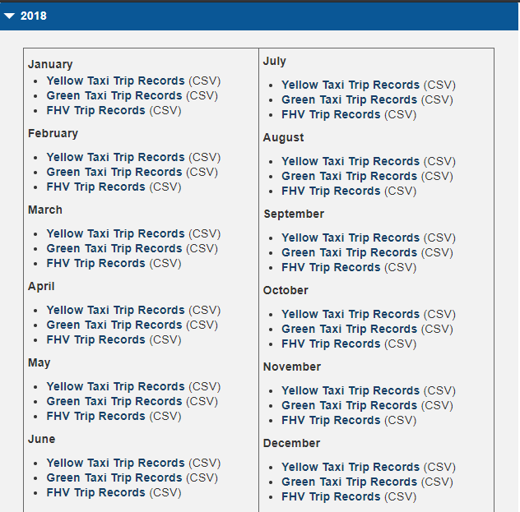
NYC-TLC Dataset
It has records of all taxi trips (Yellow, Green) from year 2009 to 2020. The difference between Yellow and Green taxis is in the zones of operating.
To take the most recent data and to avoid the Covid situation we decided to take data samples from all the months of 2018 to train/test our model.

Slide 20
Environment (Google Colab)
What is Google Colab?
Colab or Colaboratory is a free laboratory from Good Research. It is a Web IDE used to execute python code through the browser in a predefined environment (Zero Configuration required).
Which saves us lots of time and work that it would require if we decided for instance to use Jupyter Notebook (Colab is just a more flexible online version of Jupyter notebook).
Colab is easy to use and makes it easy to share files because it stores your files in the cloud (Google Drive).
Colab is mainly used to train ML and DL models.
Colab also allows us to train our models using CPU, GPU or TPU (Tensor Processing Unit, good for Tensorflow projects).
Large datasets such as the one we have, produces much faster results using GPU rather than using CPU. So here comes another advantage of Google Colab if you don't have a GPU in your Computer.

Slide 21
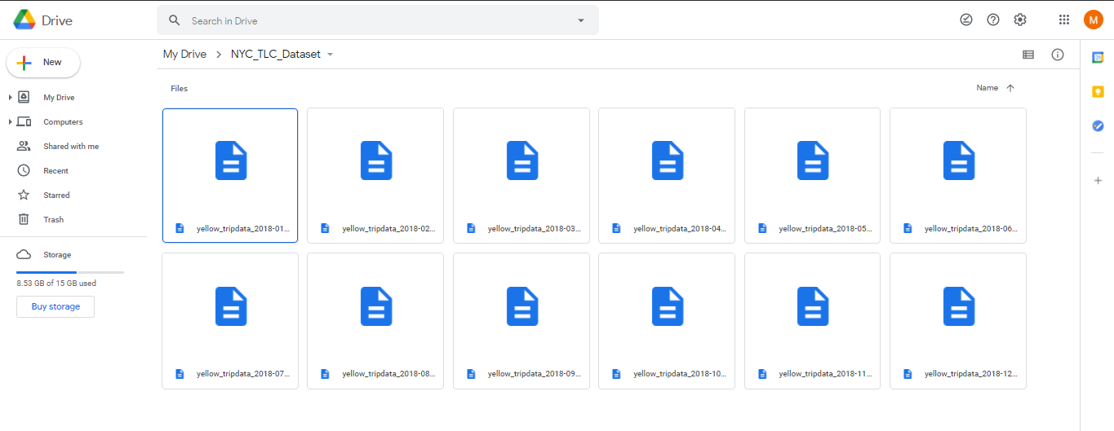
Dataset -> Drive
As we can see in the fig on the right, our dataset (All the 12 months on 2018 yellow CSV files) were first downloaded from the NYC-TLC Official website and then uploaded to Google Drive.
The size of each one of these 12 files lays between 660MG as a minimum and 793MG as a maximum.

Slide 22
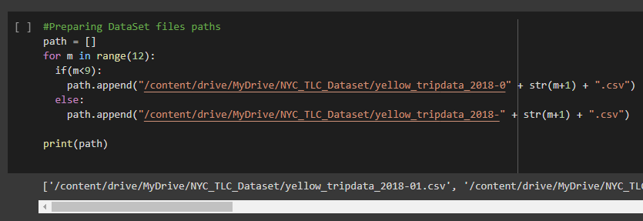
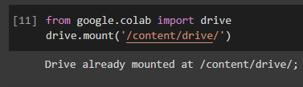
Drive -> Colab
First we Mount Google Colab to Drive:
Then we can copy the paths of our dataset files on the drive and save them in an array of 12 Strings called path

Slide 23
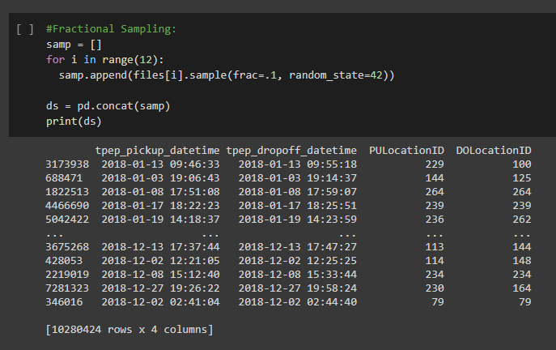
Fractional Sampling
Now we can get a sample from each file we have using a certain % row observations from this file. This Technique can be useful if we want the data to be more representative compared to the file sizes.
In both methods, at the end we are using pd.concat() function to concatenate all the 12 sampled results in a single final dataframe which will represent our final dataset

Slide 24
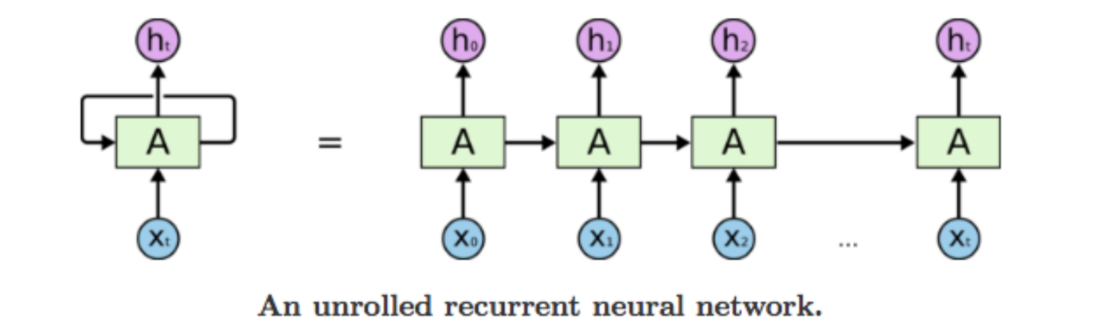
Recurrent Neural Networks
RNNs (Recurrent Neural Networks ) are a special type of neural network designed for sequence problems. Simplest example of RNN model can be:
Input: Sequence of integers {4,5,6,7,8}.
Output: Next Digit in the sequence {9}.
A recurrent neural network can be thought of as the addition of loops to the architecture. For example, in a given layer, each neuron may pass its signal sideways in addition to forward to the next layer. The output of the network may feedback as an input to the network with the next input vector. And so on…

Slide 25
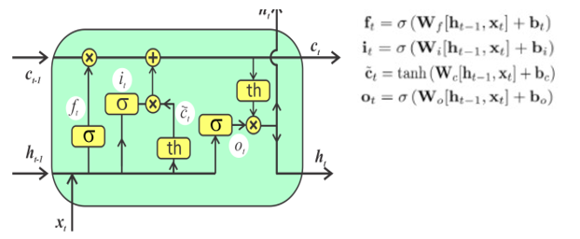
LSTM
LSTM is a powerful type of RNN that is trained using Back propagation through time and overcomes the vanishing gradient problem. LSTM have proven to be so powerful in the domain in training time series data.
It can be thought of as a memory
that includes four gates and several
Activation functions (fig).
Using Python we can build LSTM model with Keras.
What is Keras?

Slide 26

Tensorflow
Before answering the question “What is Keras?” we need to answer:
What is Tensorflow?
It is an open-source python library used for fast numerical computing. It was created and released by Google. It is mainly used to create machine learning and deep learning models.

Slide 27

Keras
Keras is a powerful and easy-to-use free open source python library created by Google to
make developing and evaluating machine learning and deep learning models as fast and easy as possible. It is a high-level interface and it is built on top of Tensorflow (it uses Tensorflow in the back-end). Just like Tensorflow, Keras can operate on different machines. But GPU is suggested for best performance. Keras allows us to define and train neural network models in just few lines of code. And it is widely used for both research and development purposes.

Slide 28
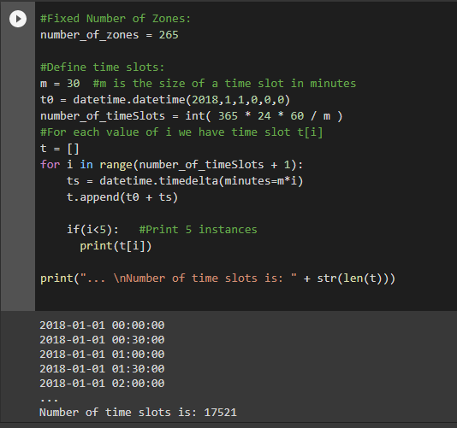
Time Slots Definition
To work with time in python:
import datetime
First we define a variable m which will represent the size of a time slot (for this run we took m=30 minutes).
And we define t0 to be the first datetime in the dataset: 1/1/2018 00:00:00.
Now it is straight forward to calculate the number_of_timeSlots: days*hours*minutes/m
And finally we run a for loop that creates a list t containing datetime values that covers the time slots throughout the whole year.

Slide 29
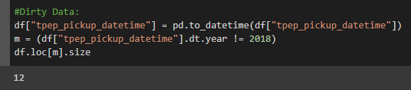
Garbage Data
Upon analyzing the data, it turned out that there are some row observations in our dataset (months of 2018) has wrong dates with years different than 2018.
To solve this problem:
We get raid of these records through the process of data selection, while building X and Y. (We make sure that during this selection, non of the these observations will be chosen).

Slide 30
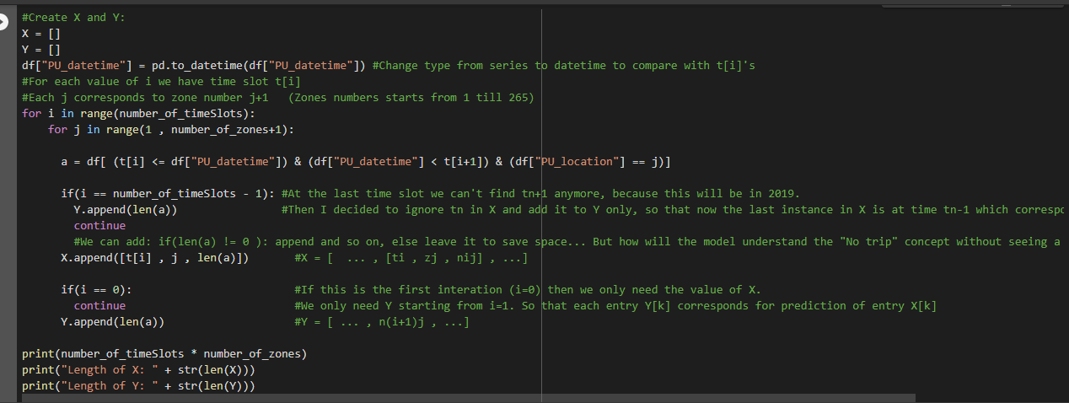
X & Y Creation

Slide 31
Environment (Hardware / Colab) Limitations
We faced many difficulties due to the idea that we have a huge data, and we need to train a big model using either Colab or low level hardware personal computer (This is a common problem that many ML developers face).
We decided to use Colab but there were still many limitations and difficulties to deal with during working with Colab because:
Google Colab notebooks have an idle timeout of 90 minutes and absolute timeout of 12 hours. This means, if user does not interact with his Google Colab notebook for more than 90 minutes, its instance is automatically terminated. Also, maximum lifetime of a Colab instance is 12 hours.
And in order to proceed with all the stages (Data preparation , Model Design/Training/Testing) with a big dataset, it takes much more time (such models can take up to 24 or 48 hours), then it was not possible with the current tools to make one big run and get a final result directly. So I had to find other ways!

Slide 32
How to avoid these limitations?!
The main ideas I used to avoid these limitations as much as possible and come up with a final results are through:
Starting with smaller data samples and smaller number of time slots (time slots of bigger size), to see how much data can Colab process and handle before disconnecting. And the purpose here is to try to gradually benefit from the maximum possible resources at the end of the experiment.
Saving data (dataset samples, dataframes, arrays, X and Y, …) into files in Google Drive, at several check points. So that if Colab disconnected, I can load the data again (with less time) instead of processing the data again.
It took some time to manage these methods. It also took more code and energy. But the good news is: I am able to work with more flexibility now, and I was able to avoid there limitations somehow.
But for this we will need to performs many runs in order to keep going step by step until we reach Colab maximum available resources. And this could be something good because we will have several samples and several runs that we can analyse and study, before reaching the best possible result.

Slide 33
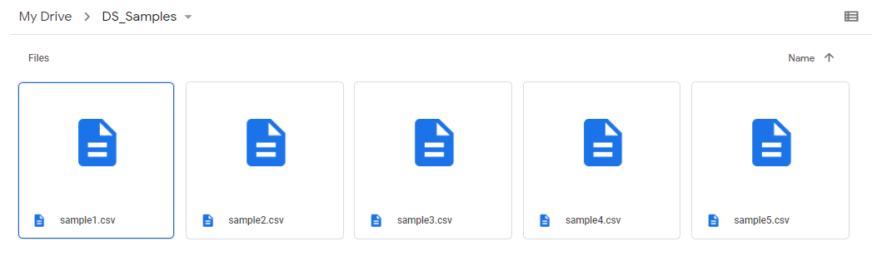
Different Data Samples
sample1: .01Y .1G 1028042+880730= 1908772
sample2: .001Y .01G 102804+88073= 190877
sample3: .000Y .001G 10280+8807= 19087
sample4: .00001Y .0001G 1026+882= 1908
sample5: .000001Y .00001G 102+89= 191

Slide 34
Different Time Slots
The creation of time slots is not a problem, so we can take any possible size of time slots that we would like to take, but for our goal I am focusing on these 3 for now:
30 minutes: 17521 time slot
10 minutes: 52561 time slot
5 minutes : 105121 time slot
Time Complexity of X and Y creation:
number_of_timeSlots * number_of_zones + "The Pandas queries time complexity which depends on the Data Sample Size"

Slide 35
Model training
In order to train our designed model on X and Y, we are going to split our dataset into "Train
Dataset" and "Test Dataset". Then we will use Keras which allows us to compile and train the model using K-Fold cross validation technique.
Then we have to run the training of our model using fine tuning. In this method, some attributes that can be changed and tested during the model design building to get a better result are being changed accordingly, including:
dataset size
train_test_split ratios
activation functions (relu, softmax,...)
seq_len (day, week../)
optimizer (adam, SGD,...)
Learning rate: Lr
batch_size
number of epoches

Slide 36
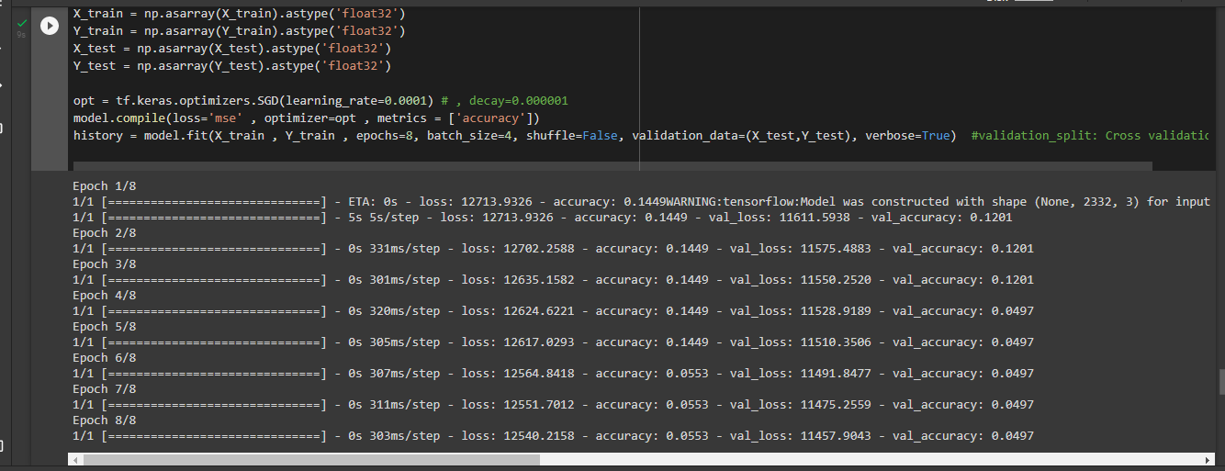
Run1
f

Slide 37
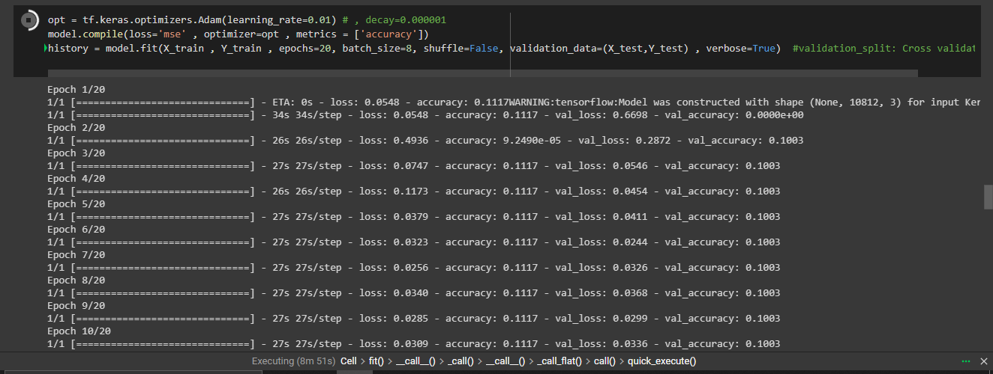
Run2
f

Slide 38
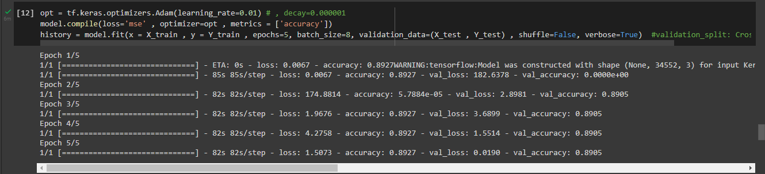
Final Run

Slide 39
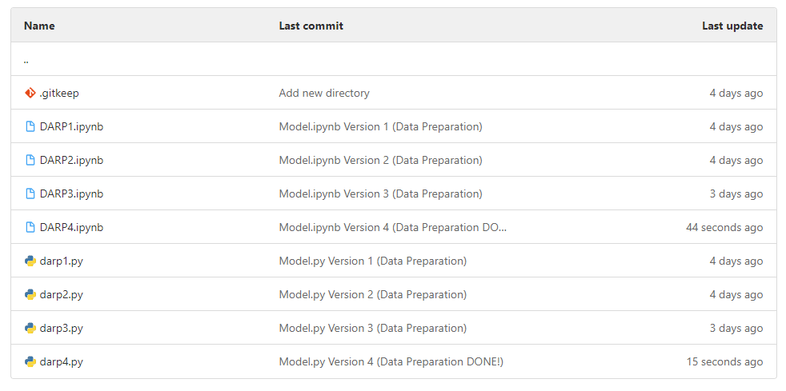
Gitlab

Slide 40
Conclusion
In this work we focus on building a machine learning model that can predict the number of taxi demands in each zone in New York city at different time slots of the day. For the purpose of the training of this model we extract data from the NYC dataset which contains real taxi trips records from different zones in the city. Having such sequential data allows our model to train through RNN, and in particular LSTM layers. The trained model predictions can be added to the agents belief base in an existing multi-agent simulation of different request allocation mechanism to test how the agent's behavior in the system could change after learning new information from the prediction model. And if this could lead to a better allocation quality in the system. Which could result an improvement in the profit of the taxi companies and for a better passengers satisfaction.

Slide 41
References:
[1] Alaa Daoud, Flavien Balbo, Paolo Gianessi, Gauthier Picard. ORNInA: A Decentralized, Auction based Multi-agent Coordination in ODT Systems: Online Rescheduling with Neighborhood exchange, based on Insertion heuristic and Auctions. AI Communications, IOS Press, 2021, 34 (1), pp.37-53. 10.3233/AIC-201579. hal-03037353.
[2] Alaa Daoud, Flavien Balbo, Paolo Gianessi, Gauthier Picard. A Generic Multi-Agent Model for Resource Allocation Strategies in Online On-Demand Transport with Autonomous Vehicles. Proceedings of the 20th International Conference on Autonomous Agents and Multiagent Systems (AAMAS 2021), May 2021, London, United Kingdom. pp.3. hal-03093017.
[3] Jun Xu, Rouhollah Rahmatizadeh, Ladislau B¨ol¨oni and Damla Turgut Department of Electrical Engineering and Computer Science University of Central Florida, Orlando, FL “A Sequence Learning Model with Recurrent Neural Networks for Taxi Demand Prediction“ 2017 IEEE 42nd Conference on Local Computer Networks.
[4] Doyup Lee1, Suehun Jung2, Yeongjae Cheon, Dongil Kim, Seungil You "forecasting taxi demands with fully convolutional networks and temporal guided embedding" at openreview.
[5] Ioulia Markou*, Kevin Kaiser, Francisco C. Pereira "Predicting taxi demand hotspots using automated Internet Search Queries" Transportation Research Part C 102 (2019) 73-86
[6] K. Zhang, Z. Feng, S. Chen, K. Huang, and G. Wang, "A framework for passengers demand prediction and recommendation" in Proc. of IEEE SCC'16, June 2016, pp. 340-347.
[7] R.R.S. van Lon, T. Holvoet, G. Vanden Berghe, T. Wenseleers and J. Branke, Evolutionary synthesis of multi-agent systems for dynamic dial-a-ride problems, in: Proceedings of the fourteenth international conference on Genetic and evolutionary computation conference companion - GECCO Companion '12, ACM Press, Philadelphia, Pennsylvania, USA, 2012, p. 331. ISBN 978-1-4503-1178-6. doi:10.1145/2330784.2330832.
[8] Luis Moreira-Matias, Joao Gama, Michel Ferreira, Jo~ao Mendes-Moreira, Luis Damas "Predicting Taxi-Passenger Demand Using Streaming Data" IEEE Transactions on Intelligent Transportation Systems ( Volume: 14, Issue: 3, Sept. 2013).

Slide 42
Thank You!

